Slide 1
GRID COORDINATES
Lesson 1: Introduction

Slide 2
Learning Goal
Success Criteria:
✓ I can identify the X and Y axes.
✓ I can remember the "Run then Jump" rule.
✓ I can find coordinates (x, y) on a grid.

Slide 3

The Golden Rule
Before you can jump up to the stars...
RUN before you JUMP!
1. RUN across (X-axis)
2. JUMP up (Y-axis)

Slide 4
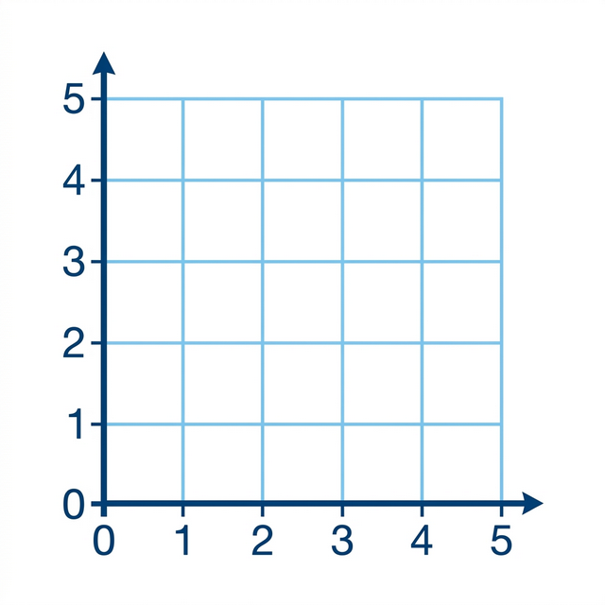

Treasure Hunt!
Where is the loot?
1. Run 3 steps across.
2. Jump 2 steps up.
( 3 , 2 )

Slide 5
To the Moon!
Rocket coordinates?

Slide 6
Your Turn!
Time to hunt for coordinates on your sheet.

